Slide 1
FACE RECOGNITION
KSP-IPH-2019-table30
MEMBERS:
Anil Chandra Naidu Matcha
Shubham Agnihotri
Kiran Penumarthi
Chirag Saraiya

Slide 2
PROBLEM STATEMENT
Find the photo of a missing person from police database or string of other official databases or some social media platforms and internet in general.

Slide 3
BLOCKERS
The Dataset Provided is of low resolution, hazzy, and inadequate in Number.
The above blocker blocks us down to avoid OpenCv approach and directs us to Deep Neural Networks(DNN). Training a DNN requires a Huge amount of data.

Slide 4
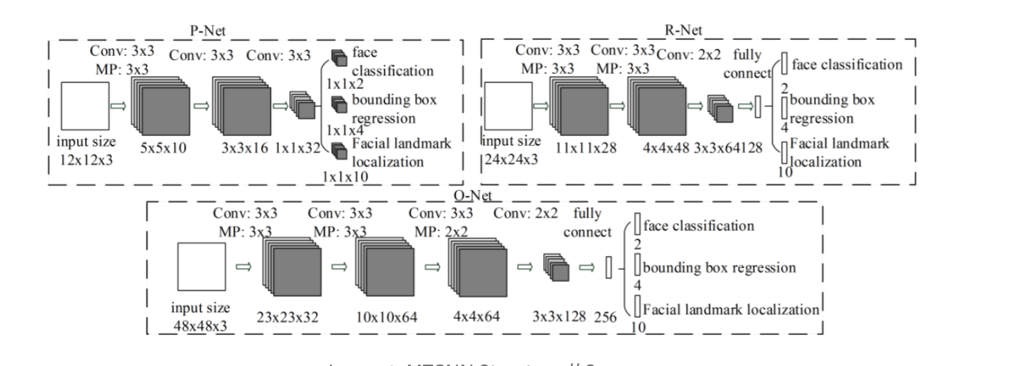
Approach:
We divided the problem into 2 stages
1>1st stage consists of Face detection i.e detecting a face and it's coordinates in an image. We did this by using MTCNN architecture.

Slide 5
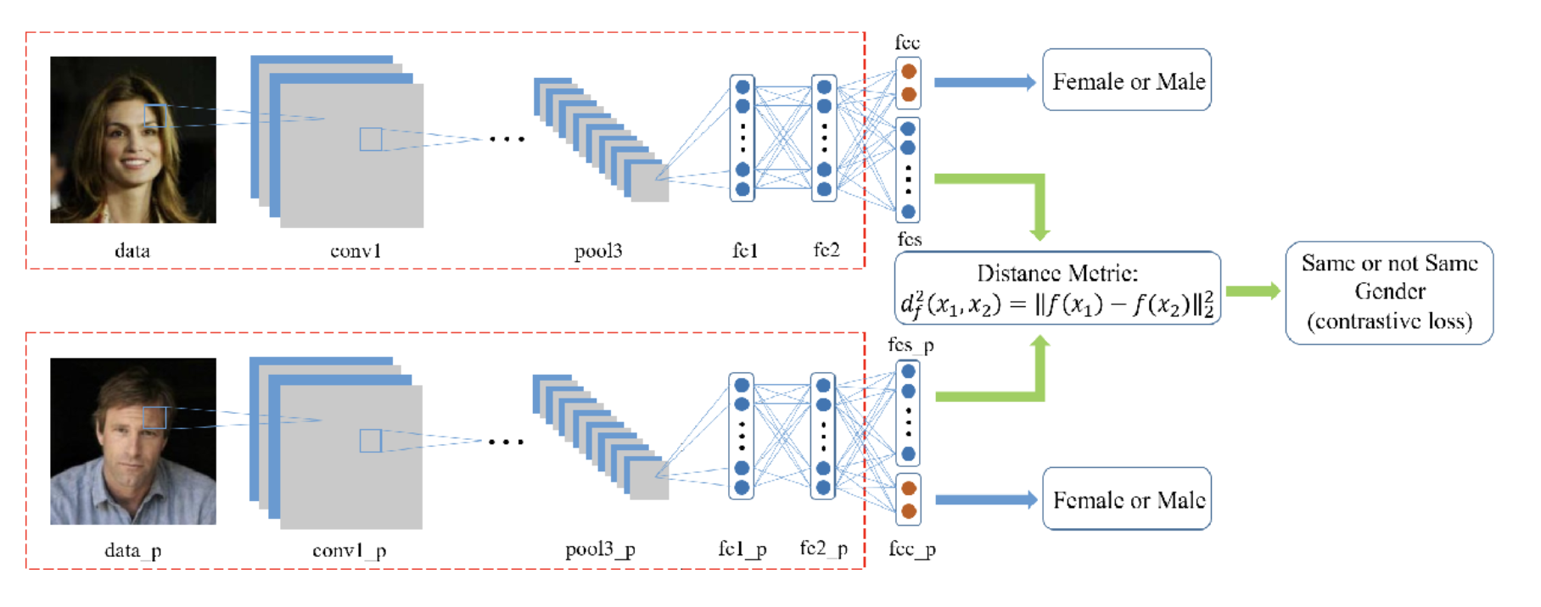
2>Face Recognition For face recognition we used a Inception-Resnet based architecture to recognize the faces sent by detector. Detector crops the image across the bounding box which is sent to recognizer

Slide 6
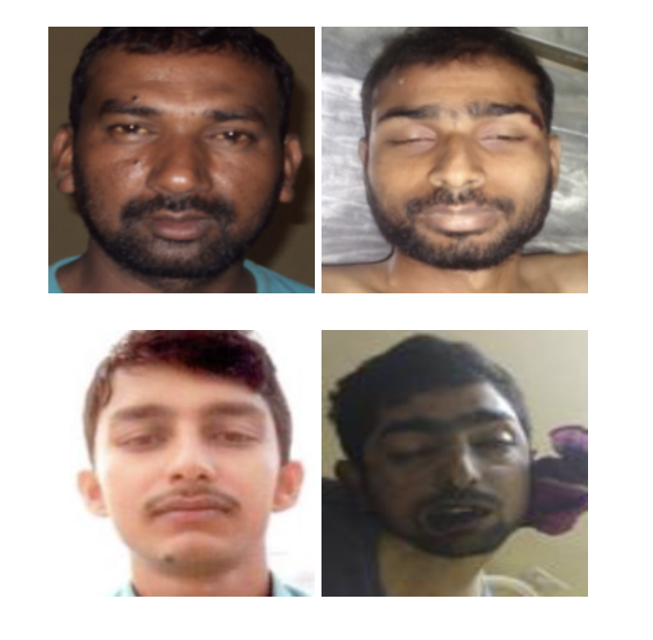
Results:
The main task of the competition is to match images of people dead by natural causes with images from arrested/wanted/missing people images and to provide best match. As we can see the outputs are pretty awesome considering the limited amount of data and the noise present in most of the dead images

Slide 7
Facial Recognition over given database:
We have developed an Algorithm which gives 97.9 % accuracy which is comparable to the state of the art given it was trained over a very clean and good dataset.
Facial Recognition over internet data:
We wanted to check the model performance on unseen type of data. So we have scraped web for data of 30 celebrities and were able to produce similar results as above mentioned
Facial Recognition on different hardware data:
We wanted to test model reliability by checking with images taken from different hardware devices such as multiple phone cameras, webcam from computer etc. and our model was able to recognize all the variants with reliable accuracy.
Facial Recognition on different hardware data:
We ran the model over a live webcam and the model was able to work at a speed of 5 - 10 Frames Per Second(FPS).

Slide 8
Choice of Technology
Tensorflow, Keras
Google colab
Open source India face dataset
Facenet, MTCNN

Slide 9
THANK YOU!!!!!
Q & A ?

